Slide 1
Harmonized Landsat Sentinel time series analysis in the cloud
Todd Hawbaker, Jodi Riegle, and Kehan Yang
https://github.com/tjhawbaker/nch21_hls_timeseries

Slide 2
Project Goals
A cloud-deployable framework to identify burned areas in the harmonized Landsat Sentinel-2 data, and possibly other remotely sensed data sources. Basically, extending what we've done with Landsat to HLS data. The product we are planning is code or a container that users could run in the cloud to generate a time series of burned area products for their area of interest.

Slide 3
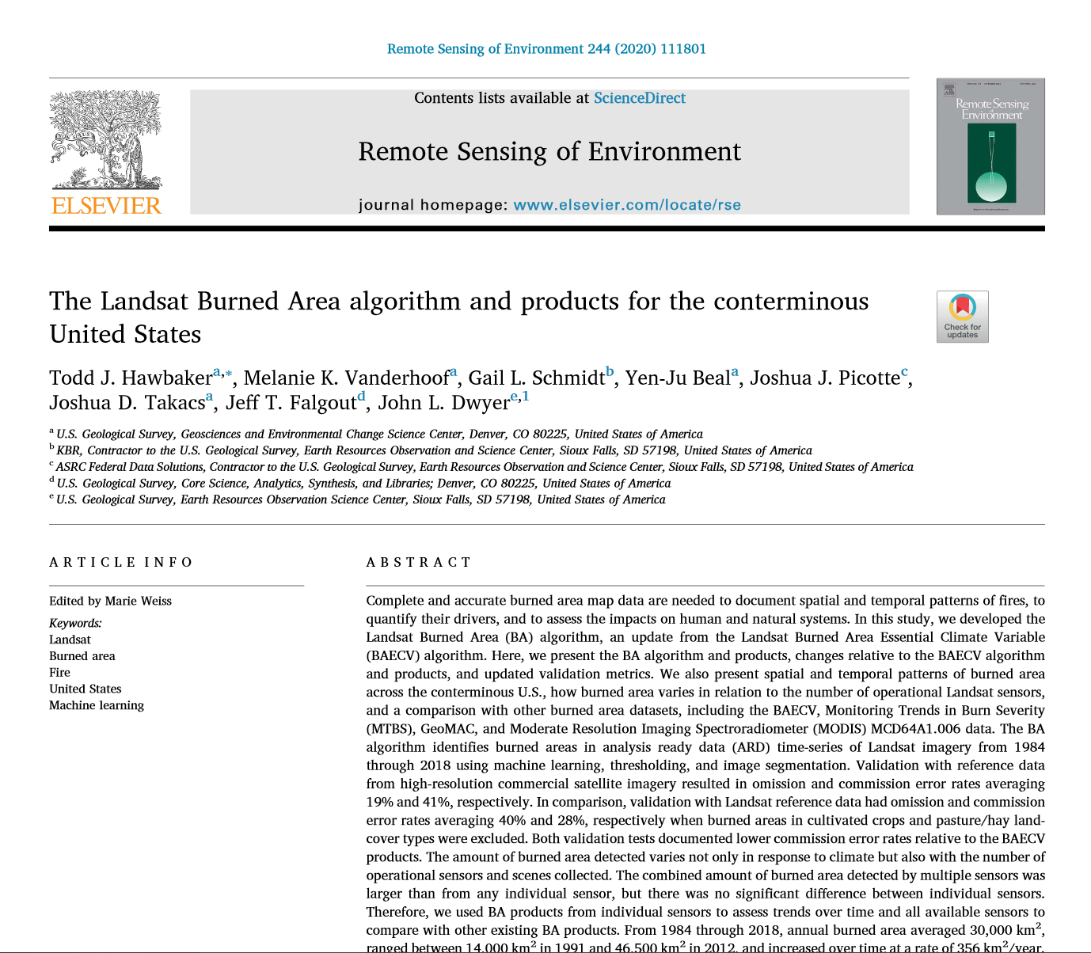
Project Goals

Slide 4
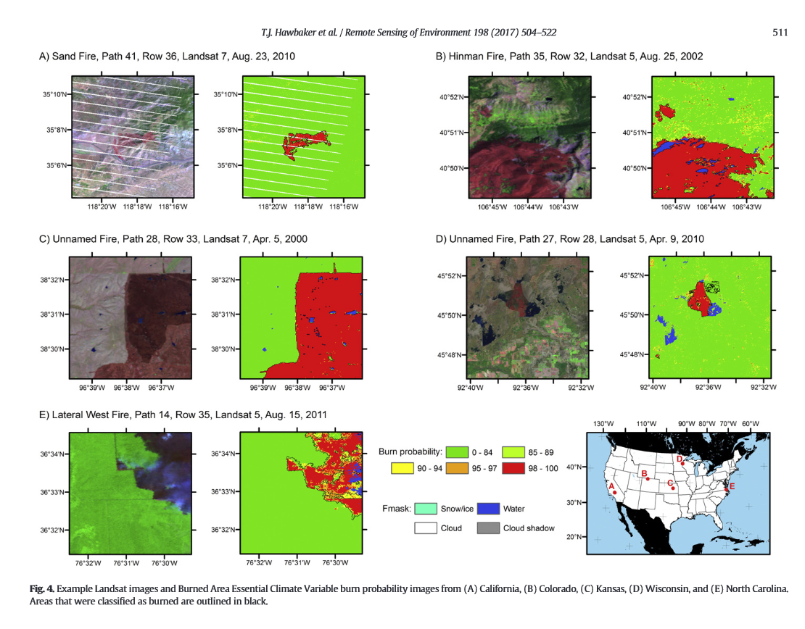
Project Goals

Slide 5
Project Use Case/Workflow outline
Built a tool to query and acquire links to HLS data from the EarthData library.
With the found links, created a rioxarray Dataset consisting of DataArrays for bands shared by Sentinel and Landsat, with date and time information.
Used band math to add spectral indices to the Dataset.
Visualized QA masks and spectral indices.
Applied a moving window to the time series of spectral indices (e.g., mean NDVI over the past 30 days).
Calculate the difference between spectral indices for each scene and the moving window time series.
Apply a classifier to the spectral index differences and save the results.

Slide 6
Project Use Case/Workflow outline
Built a tool to query and acquire links to HLS data from the EarthData library.
With the found links, created a rioxarray Dataset consisting of DataArrays for bands shared by Sentinel and Landsat, with date and time information.
Used band math to add spectral indices to the Dataset.
Visualized QA masks and spectral indices.
Applied a moving window to the time series of spectral indices (e.g., mean NDVI over the past 30 days).
Calculate the difference between spectral indices for each scene and the moving window time series.
Apply a classifier to the spectral index differences and save the results.

Slide 7
Methods or services used
https://github.com/tjhawbaker/nch21_hls_timeseries
query_and_acquire_HLS_data.ipynb
CMR API and STAC to query 'https://cmr.earthdata.nasa.gov/stac/LPCLOUD’ for a given location (HLS tile centroid) and date range
Downloads query links (for comparison with direct data read from S3 links)
Save query results as a .csv file for later
read_hls_data_and_visualize.ipynb
Reads .csv of links from query_and_acquire_HLS_data.ipynb
Reads links into Xarray data series, normalizing band names (each band is a data array)
Calculates spectral indices (e.g., NDVI, NBR, NDSI)
Visualize individual images, QA bits, and spectral indices
read_hls_data_and_analyze.ipynb
Same as above, but without visualization
Adds rolling mean of NBR
Calculates NBR change for each image relative to the NBR rolling mean

Slide 8
Demo of notebook created for project

Slide 9
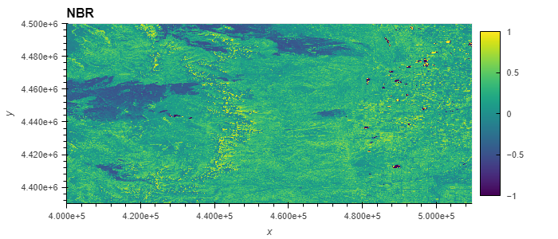
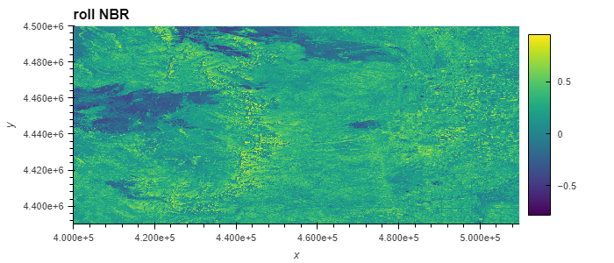
Project Use Case/Workflow outline

Slide 10
Pain points / Lessons Learned / Meeting Hackathon Goals
Everything was awesome! Learning how to use CMR and STAC to query and get links was a huge step forward. Learning how to manipulate and visualize the data with Xarray and holoviews was extremely useful too.
Learning to use functionality in the new python libraries. Committing large notebooks to git
We were heavily invested in the old model of downloading data then processing locally. Downloading was our largest bottleneck. Accessing data from the cloud helps reduce that bottleneck. Efficient queries and data reads also lets us focus more time on doing cool things with the data. Delivering our derived data in the cloud would help our stakeholders.
We learned a lot! Much work remains to incorporate what we’ve learned into our own processing pipelines.

